Slide 1
Predicting west Nile virus appearances in Chicago

Slide 2
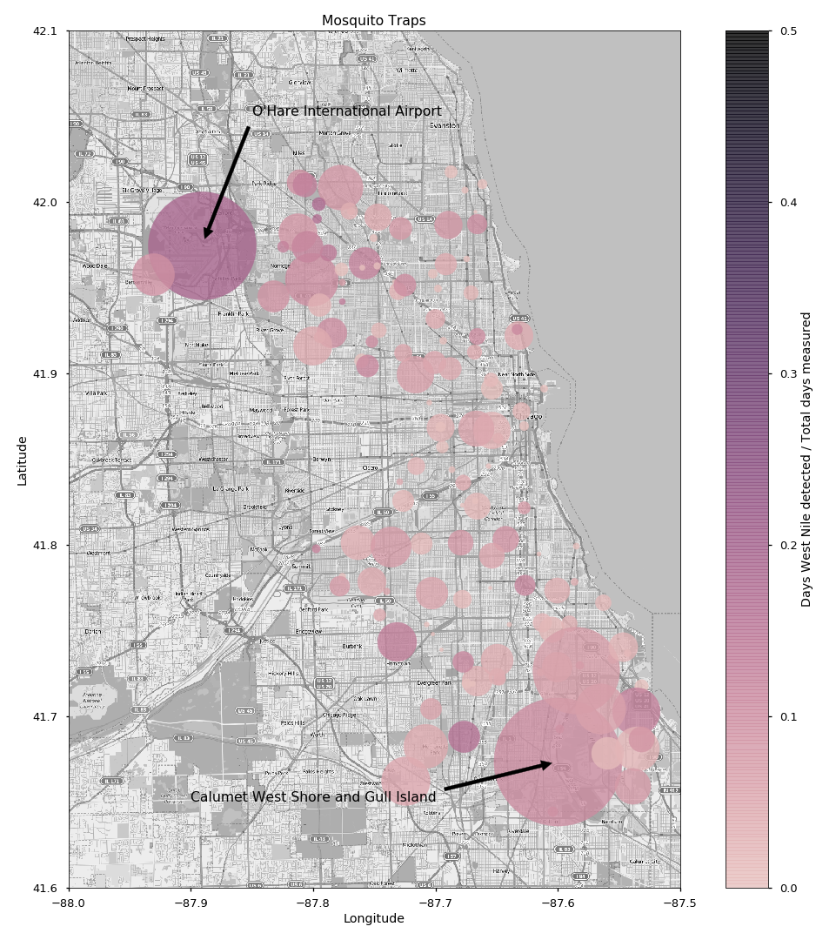
Since 2004, West Nile Virus has been a problem in the city of Chicago.
For the purposes of improving the prediction of virus appearance, a dataset was made public containing information on mosquito traps around the city.
The dataset includes information about the traps, as well as how many mosquitos they have caught, and whether West Nile Virus was detected in the trapped mosquitos.
The dataset contains data from the years 2007, 2009, 2011, 2013 and the months of May through October.
Here is plotted all of the traps whose data was provided.
The size of each point corresponds to the number of mosquitos trapped over the dataset, and the color to the percentage of observations that were infected.
O’Hare International Airport recorded the highest percentage of infected observations
Calumet West Shore and Gull Island recorded the greatest number of mosquitos trapped.
Notes:
We can see that around O’Hare, there is a higher incidence of WNV, and there are a lot of mosquitos around Calumet

Slide 3
The data
The date of each observation is supplied.
Each observation is broken down into groups of mosquito species. Only Culex Pipiens/Restuans, Culex Pipiens, and Culex Restuans have any observations where West Nile Virus is present.
The data is arranged in such a way so that no observation of a particular species will have more than 50 mosquitos detected. This does not mean that if an observation is split, it will have detected 50 mosquitos, but a maximum of 50.
For each trap, much location data is provided. Full address, latitude, and longitude are included in each observation. Since mosquitos can fly, and don’t care about streets, latitude, and longitude data is sufficient.
Also provided is NOAA weather data from two different weather stations for the time period in question.
Weather data includes daily maximum, minimum, and average temperature, departure from normal temperature, precipitation data, dew point, wet bulb temperature (which relate to humidity), heating and cooling days (which relate to how energy needed for heating or cooling), air pressure, wind data, and extreme weather flags.
For prediction, all of these data points except the number of mosquitos, and whether West Nile Virus was present can be used in the model.

Slide 4
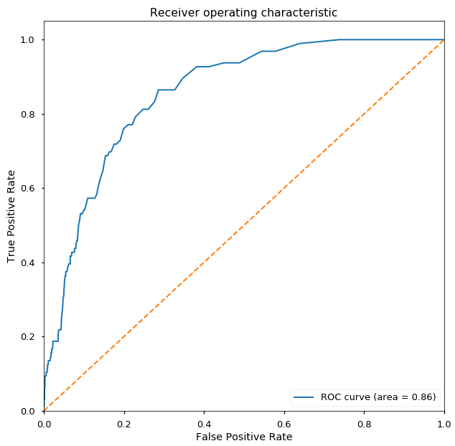
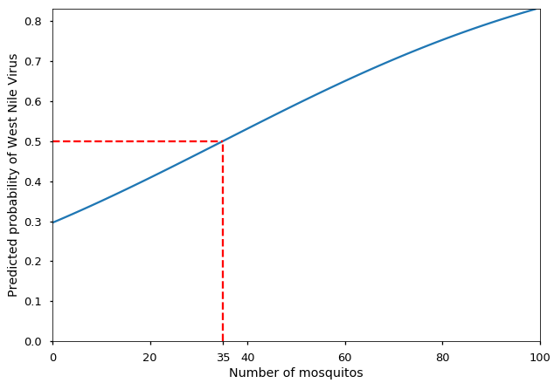
Mosquito number logistic regression
Immediately, we can use a logistic regression to predict the presence of West Nile based on number of mosquitos detected alone.
First, the data is summed for each day and trap combination.
Then, the data is split into a train and test set, preserving the ratio of positive and negative results of the whole dataset in each.
A borderline SMOTE algorithm is run on the training set to remedy the class imbalance.
Predicting on the test set, the model achieves a log loss of 0.61.
Our first insight is that once the number of mosquitos trapped is greater than 35, a spray team could be dispatched. Since mosquito number is not available in real time, to be conservative, when the first split occurs, a team should be sent out.
 | Precision | Recall | F1-score | Support
Negative | 0.96 | 0.89 | 0.92 | 1058
Positive | 0.31 | 0.57 | 0.40 | 96
Avg/Total | 0.90 | 0.86 | 0.88 | 1154

Slide 5
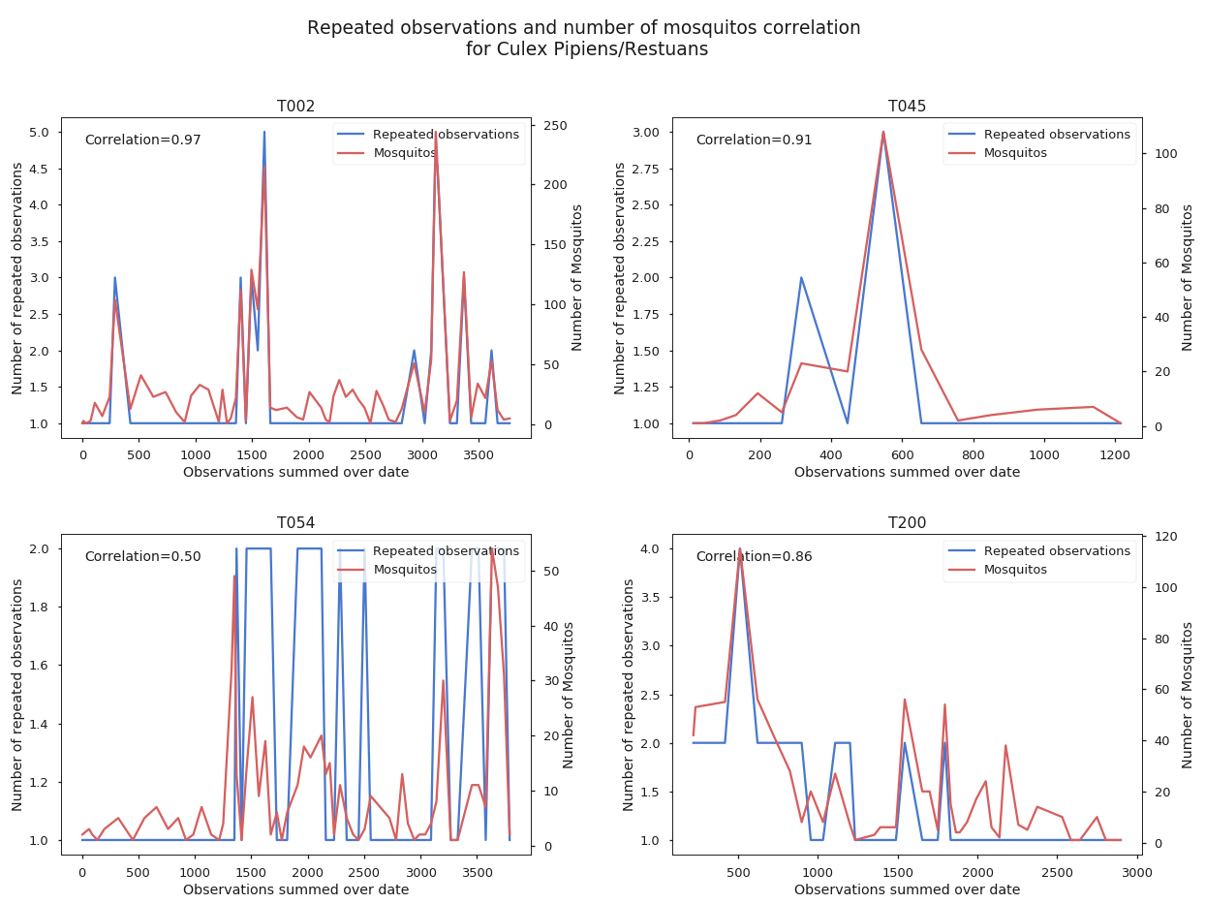
Reasonable substitute for number of mosquitos
As constructed models have shown, the number of mosquitos trapped is an excellent indicator of whether West Nile will be detected. (The best, in fact)
As this data will not be available in real-time to those trying to curtail the spread of the virus, a good approximation would help.
As mentioned before, observations are split when the number of mosquitos trapped reaches 50 (or less).
Therefore the number of mosquitos will be approximately 50 * observation splits.
This isn’t perfect. Plotted are 4 different traps, with number of trapped mosquitos summed daily, and number of repeated observations for the day.
Most are highly correlated, though some are not.

Slide 6
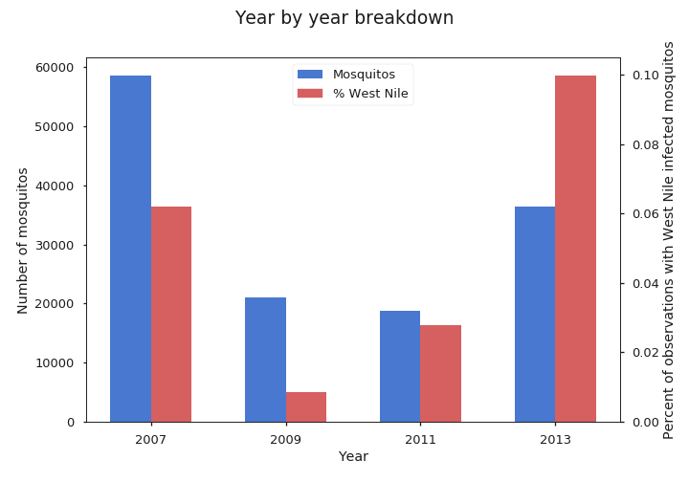
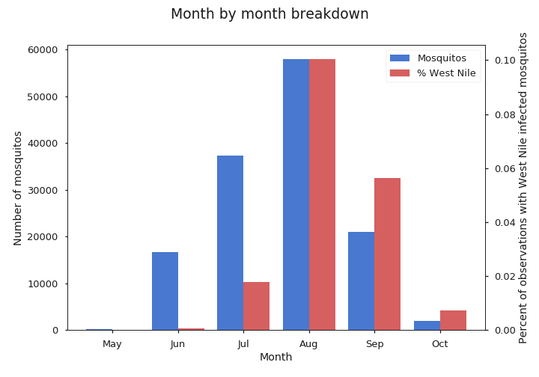
Date observations
The year and month are good indicators of both number of mosquitos and presence of West Nile Virus
Year may not be a good predictor for dates in the far future, but the trend would help with near future dates.
In 2009, West Nile and mosquito counts were down, but they have been increasing since then.
August (usually the hottest time of year) has the greatest number of mosquitos, and also the greatest occurrence of West Nile per mosquito, with these numbers decreasing as we move from there.
Both year and month were added to the dataset as one hot encodings as to work with various model types.
Notes:
Left one label out to avoid the dummy variable trap

Slide 7
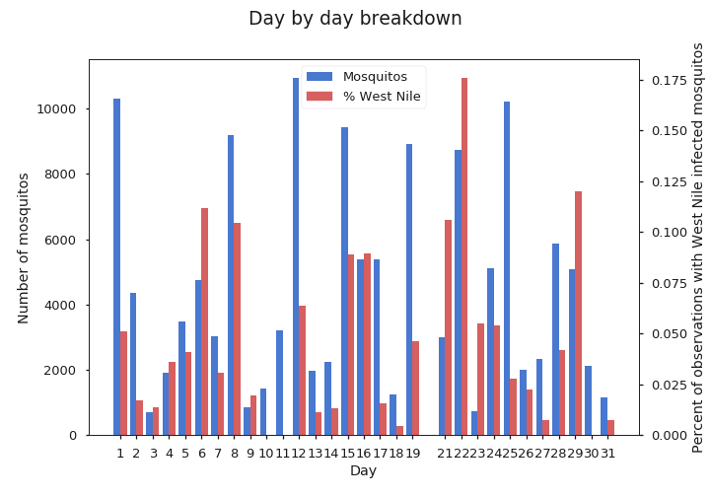
Date observations
One would not expect day of month to be a good indicator, as there are many unknown contributors to daily variation.
When plotted, we can see that the data does appear random.
Interestingly though, this does show that no data for the 20th of any month in the dataset is provided.

Slide 8
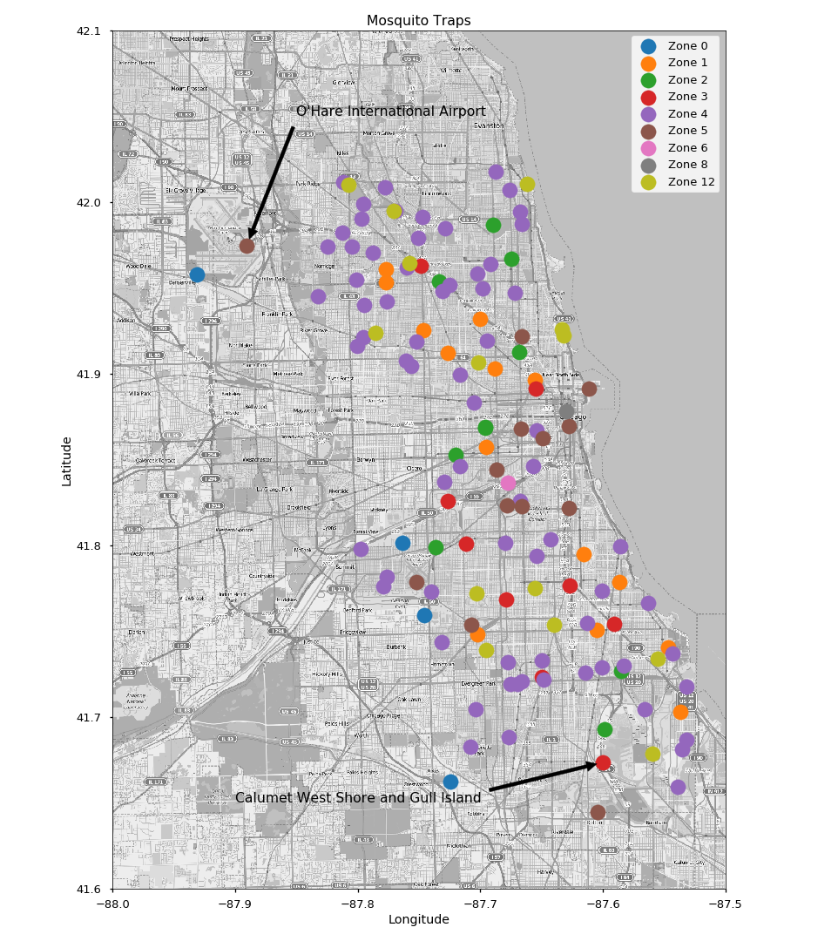
Zoning Data
Zoning data can give an idea of the immediate surroundings of a trap.
For example, one can imagine that an industrial area may not be well trafficked, and pool of water can exists where mosquitos can breed.
Alternatively, a residential area may be better maintained.
Zoning data is acquired using the SODA api from the Chicago Data Portal.
Zone 0 is a placeholder for locations not in the zoning database.
Unfortunately, the other zoning numbers are unexplained.

Slide 9
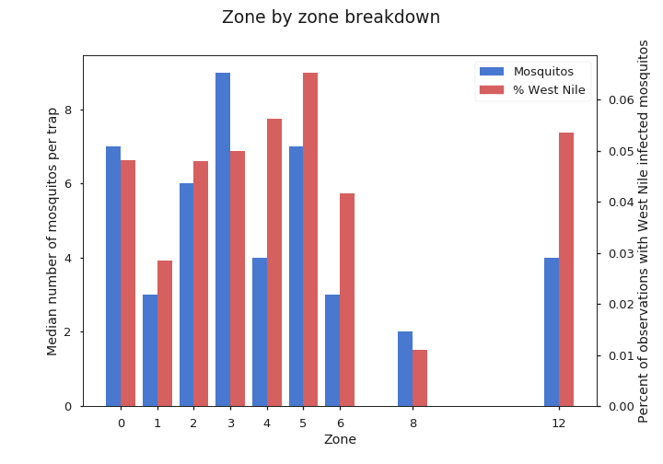
Zoning Data
Zoning data may also be a reasonable estimator for the number of mosquitos.
The trap that collected the most mosquitos over the data period, Calumet West Shore and Gull Island, is in zone 3.
The trap that had the highest instances of West Nile Virus infection, O’Hare International Airport, is in zone 5.
Notes:
Zone 5 is mostly near water

Slide 10
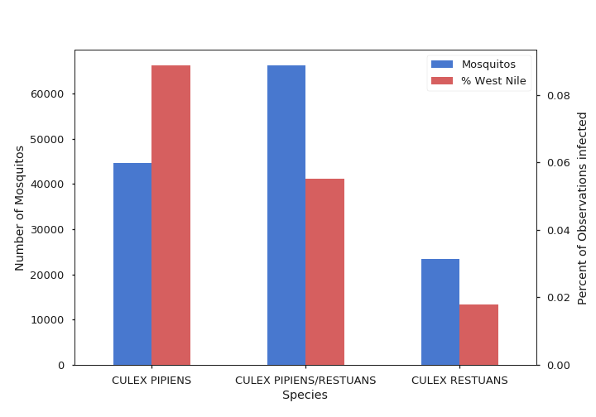
Mosquito species
Mosquito species could have an impact on the spread of the virus.
Without further research, the model will hopefully pick up on the difference.
The three species in the plot are the only ones that have a recorded instance of West Nile Virus detection.
As such, these three species are coded into one hot features that are added to the data.

Slide 11
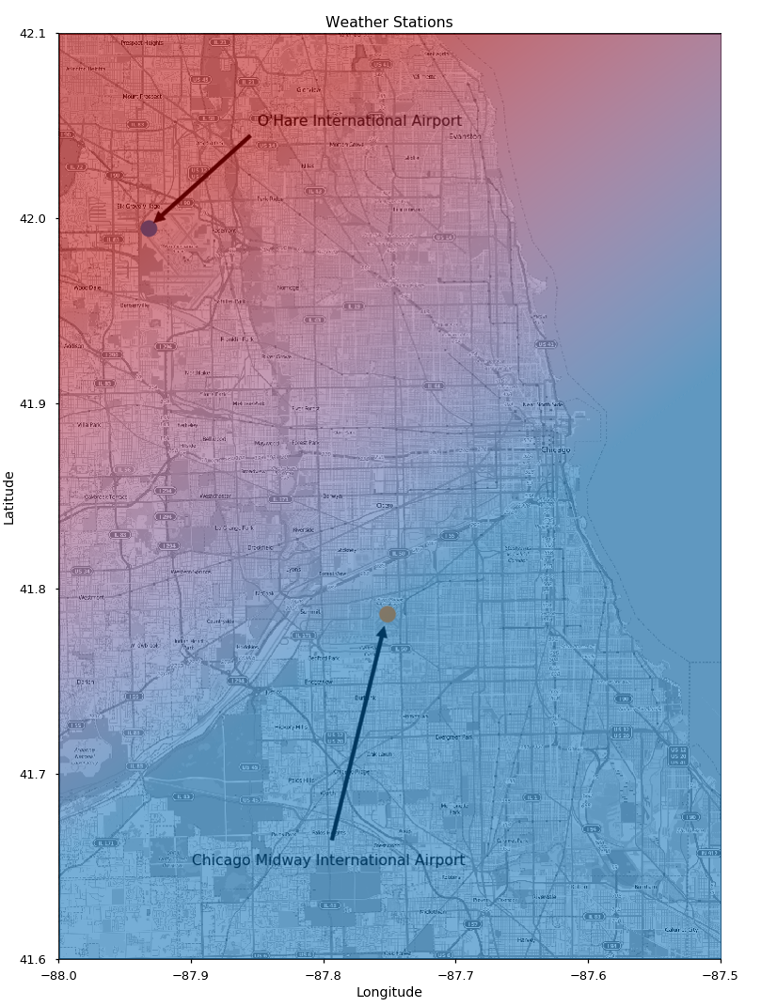
Weather Data
Weather data is provided from two stations, O’Hare International Airport and Chicago Midway International Airport.
Rather than picking one station, or simply picking whichever station is closer to a trap, an algorithm was designed to get a reasonable approximation of what the weather might be at a specific location.
After rotating the map so that the line between stations lie on the y-axis, a linear interpolation of certain weather conditions was made between the two.
Considering the one dimensional heat transfer equation with two fixed points, allowed to come to equilibrium, this is what we should expect.
Points above and below the stations on the rotated map are considered to have the same weather as the closest station.
Pictured is how an example temperature gradient would look.
20 day means of weather data leading up to the date in question, and days since rain fell are also calculated as additional features.
Weather features sunrise, sunset, days since rain, and thunderstorm and fog flags are selected based on the closest station.
Wind direction is converted to sine and cosine, as to have a cyclical variable representation.

Slide 12
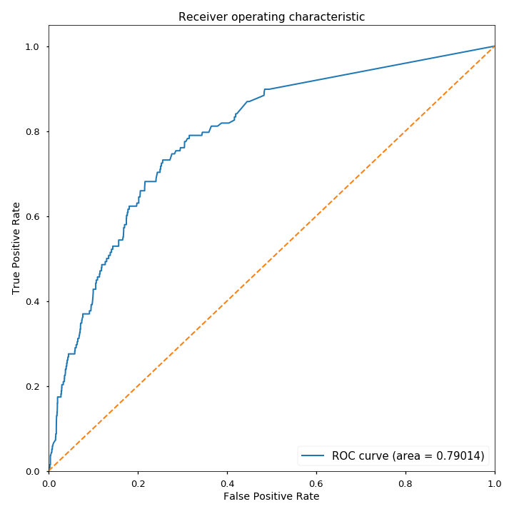
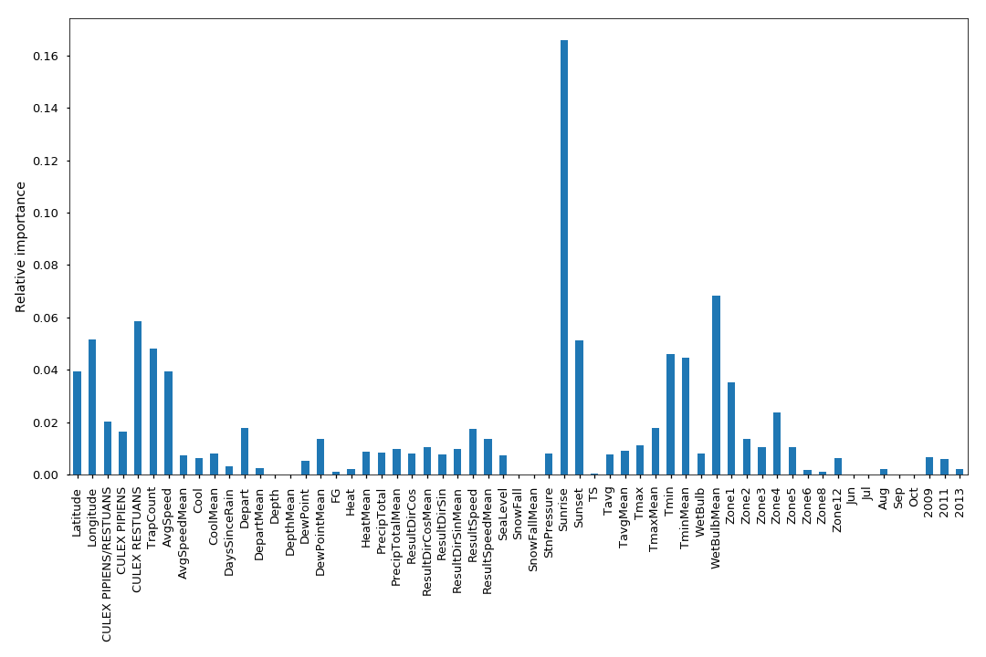
Random Forest
Using valid features (all but number of mosquitos), a Random Forest was created.
n_estimators=1000, max_features=None
Model achieves log loss of 0.42
This model certainly isn’t the best predictor, though it preforms reasonably well.
Interestingly, the most important feature of this model is sunrise.
Mosquitos are typically nocturnal, this could have something to do with it.
The next most important feature, the 20 day mean of minimum temperature, makes sense. Colder weather will lead to less mosquitos.
 | Precision | Recall | F1-score | Support
Negative | 0.96 | 0.96 | 0.96 | 2489
Positive | 0.26 | 0.28 | 0.26 | 138
Avg/Total | 0.92 | 0.92 | 0.92 | 2627

Slide 13
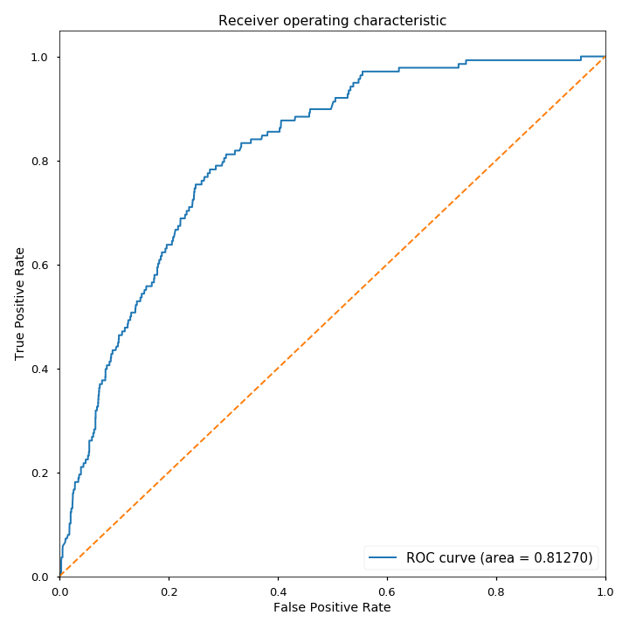
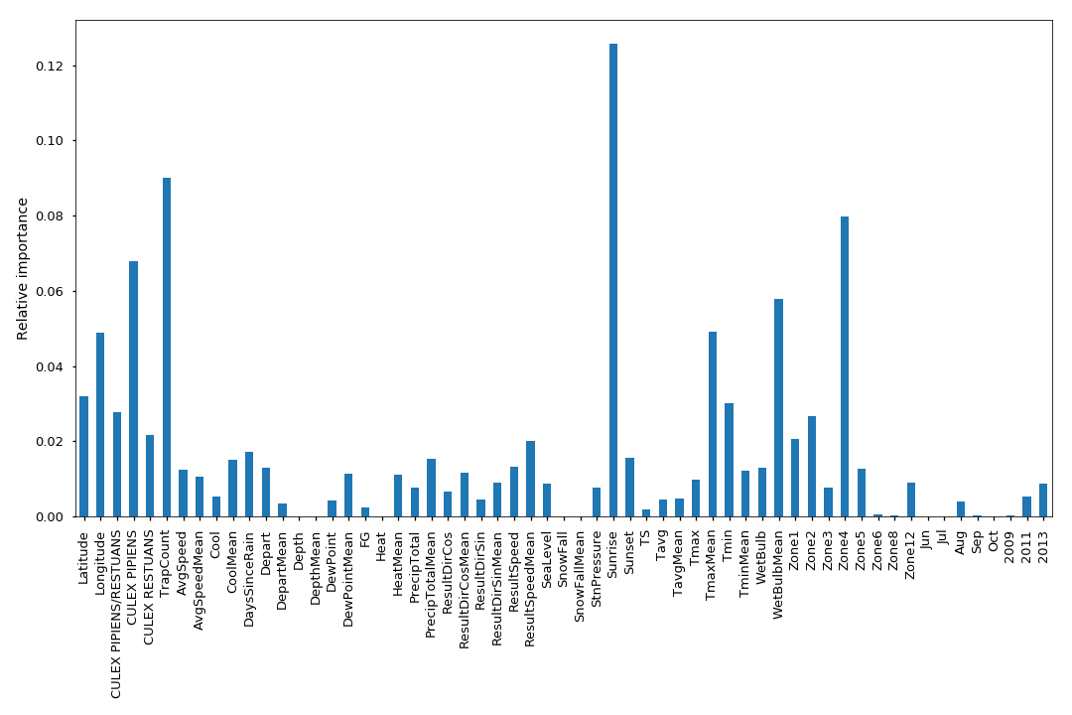
Gradient Boosting Classifier
n_estimators=1000, learning_rate=0.0035, max_depth=7
Model achieves log loss of 0.24
Though some precision is lost in positive labelling, this model is a large improvement. As can be seen by the improved AUC, changing the threshold should correct for this loss.
Again, the most important feature of this model is sunrise.
This model, has TrapCount as the second most important, which is encouraging to my theory that number of mosquitos is an important indicator.
It also makes heavy use of zone data.
 | Precision | Recall | F1-score | Support
Negative | 0.96 | 0.93 | 0.95 | 2489
Positive | 0.21 | 0.33 | 0.25 | 138
Avg/Total | 0.92 | 0.90 | 0.91 | 2627

Slide 14

Fully Connected Neural network
This particular model contains one hidden layer of 30 units, with ReLU activation and one visible layer with sigmoid activaton. There is a dropout layer of 0.2 between the layers to help prevent overfitting.
Model achieves log loss of 0.32
This model presents an increase in positive recall and AUC.
Apart from the more promising metrics, this model is rather unsuitable, as the reasoning behind the decision is hidden.
As there are so many knobs to tune, with more time, a better model could theoretically be built for prediction purposes.
 | Precision | Recall | F1-score | Support
Negative | 0.97 | 0.88 | 0.92 | 2489
Positive | 0.18 | 0.46 | 0.26 | 138
Avg/Total | 0.93 | 0.86 | 0.89 | 2627

Slide 15
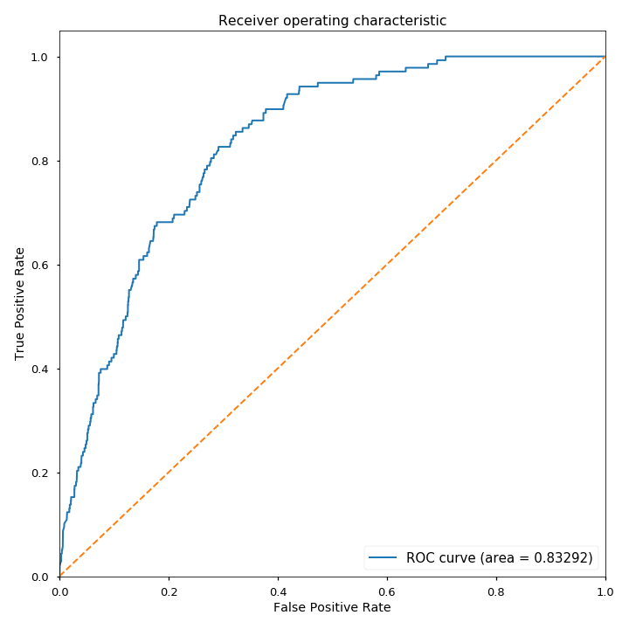
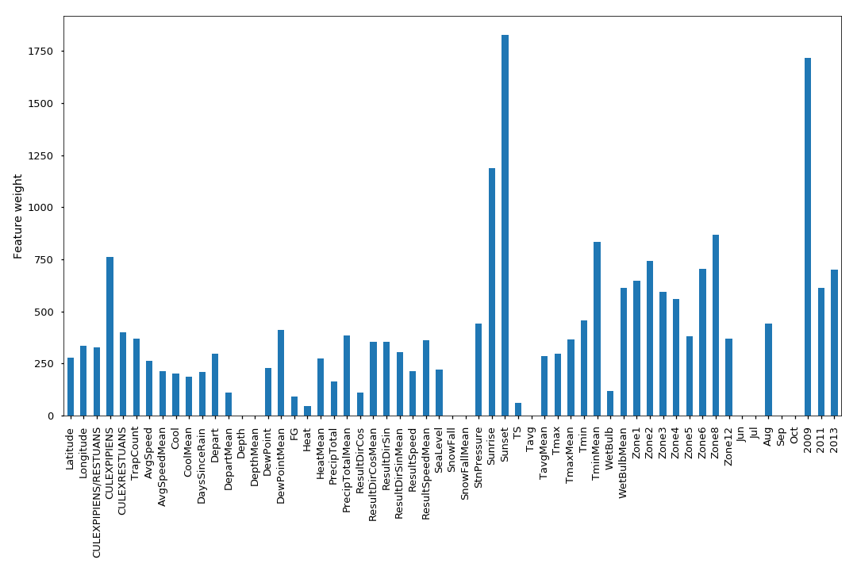
Extreme Gradient Boosting
Lastly I tried extreme gradient boosting, from the package xgboost
eta=0.2, max_depth=5
Model achieves log loss of 0.24
Of all the models, this one provides the best log loss and AUC.
This model, like the others, has sunrise and sunset at high importance in the model.
Also, like the others, the 20 day previous mean temperatures have high significance.
 | Precision | Recall | F1-score | Support
Negative | 0.96 | 0.93 | 0.95 | 2489
Positive | 0.22 | 0.37 | 0.28 | 138
Avg/Total | 0.92 | 0.90 | 0.91 | 2627
Notes:
eta - step size shrinkage used in update to prevents overfitting. After each boosting step, we can directly get the weights of new features. and eta actually shrinks the feature weights to make the boosting process more conservative.
Weight - the number of times a feature appears in a tree

Slide 16
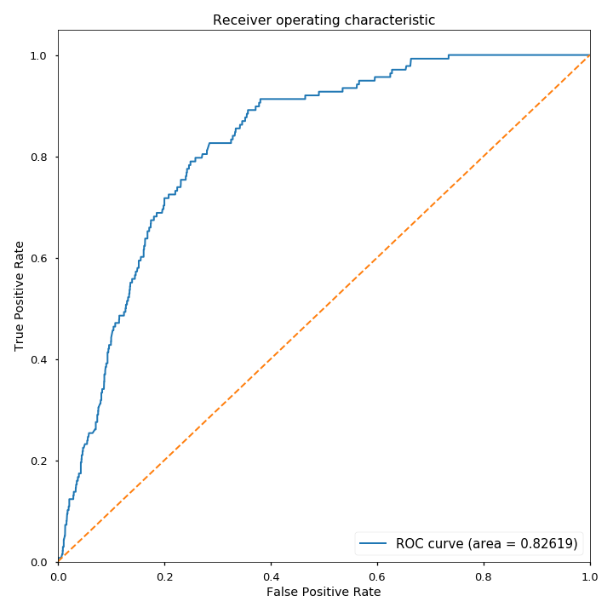
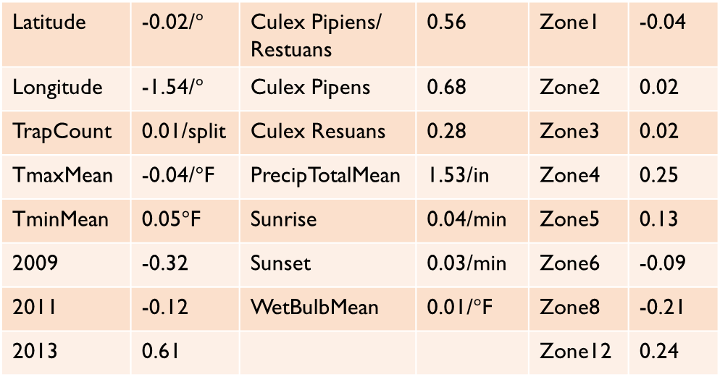
Ridge Classification
Using the top features from the XGBoost model, and features important to both the random forest and gradient boosting classifier, a ridge linear model was trained.
Leave-One-Out cross validation was used to select alpha.
Log loss of 0.55
This model not only gives us great positive recall on a threshold of 0.5 (though the precsion isn’t great), but we can also examine the coefficients.
Likelihood of West Nile Virus is highest in the South West.
Liklihood of WNV increases:
with more precipitation.
as sunrise and sunset get later.
as WetBulbMean(humidity) goes up.
as the minimum temperature goes up, but the maximum temperature goes down.
 | Precision | Recall | F1-score | Support
Negative | 0.98 | 0.74 | 0.84 | 2489
Positive | 0.14 | 0.80 | 0.24 | 138
Avg/Total | 0.94 | 0.74 | 0.81 | 2627
Latitude | -0.02/$°$ | Culex Pipiens/ Restuans | 0.56 | Zone1 | -0.04
Longitude | -1.54/$°$ | Culex Pipens | 0.68 | Zone2 | 0.02
TrapCount | 0.01/split | Culex Resuans | 0.28 | Zone3 | 0.02
TmaxMean | -0.04/$°$F | PrecipTotalMean | 1.53/in | Zone4 | 0.25
TminMean | 0.05$°$F | Sunrise | 0.04/min | Zone5 | 0.13
2009 | -0.32 | Sunset | 0.03/min | Zone6 | -0.09
2011 | -0.12 | WetBulbMean | 0.01/$°$F | Zone8 | -0.21
2013 | 0.61 |  |  | Zone12 | 0.24
Notes:
Latrange = 0.5, lonrange=1.5

Slide 17
Conclusions
The greatest predictor of West Nile Virus is the number of mosquitos captured. If there were some way to get this information in real time, predictions could be improved dramatically.
The ridge classifier presents some rather unintuitive results, such as the probability of WNV decreasing with 20 day maximum temperature mean. Perhaps the virus is susceptible to high heat.
WNV becomes more probable as sunrise and sunset move later in the day. This is unlikely to be seasonal variation, as sunrise and sunset move in opposite directions as the seasons change. The only explanation I can think of is that humans, on the clock, have something to do with the spread. It’s possible that people moving around before sunrise can disturb populations of mosquitos, which then pick up the disease while flying around.
Most zones are hard to interpret, but Zone12 seems to be mostly parks and open areas. More care needs to be taken in eliminating breeding grounds.

Slide 18
Further study
Find a way to get real-time mosquito trap data!
Data from more weather stations would allow for a more accurate estimate of the weather at any particular trap.
Zone information is a tricky feature. If a trap is located in a particular zone that is surrounded on three sides by a different zone, it’s not a good indicator. There must be another way to encode what a trap’s immediate surroundings are like.
Mosquitos breed in stagnant water. A useful feature could be the distance from a trap to the nearest water location.
The disease is mainly spread from infected birds to mosquitos. Information about the migratory patterns of Chicago’s bird population could be useful.

